Slide 1
CASE STUDY
SUBMISSION

Slide 2
Business objective and problem statement
Background:
The company under consideration is a consumer finance company operating in online loan marketplace
It facilitating personal loans, business loans, and financing of medical procedures
There are risks associated with the company’s decision on loan approval:
Not approving the loan for an applicant, who is likely to repay the loan
Approving loan for an applicant, who is not likely to repay the loan
Problem statement:
This risk of financial loss (credit loss) is largely due to borrowers who default (“charged-off”)

Slide 3
Business Objective:
To understand the driving factors which are strong indicators of loan default & minimize credit loss, which can be utilized for portfolio and risk assessment
Goal of Data analysis:
To analyze the complete loan data for all loan,clean the data for any quality issues, create new variables, conduct exploratory data analysis to identify variables which indicate if a person is likely to default, which may be used for taking actions such as denying the loan, reducing the amount of loan, lending (to risky applicants) at a higher interest rate, etc.

Slide 4
Step-by-step approach:
Data understanding
Data cleaning
Categorisation of Data
Data Visualisation
Analysing the Trends
Summary

Slide 5
Data understanding and key assumptions
Original data set contains information about 39,717 applicants who have been issued loans by the company
Various consumer attributes and loan attributes are spread across 111 columns
Loans are broadly classified into the 3 categories based on their status: Fully paid, Current, Charged-off
83 columns dropped for analysis:
54 columns with 100% null values dropped
5 columns with > 5% null values dropped and not relevant for analysis basis understanding from metadata
24 columns that are of no use in our analysis (Ex:url,address,etc) are removed
Changed the data type to suit our analysis:
date related columns converted into datetime format,
Similarly, “%” suffix removed from ‘int_rate’, ‘dti’, etc.
Revised data set has 38577 rows and 28 columns

Slide 6
ANALYSIS OF LOAN STATUS
Loan Status Number of Loans
Current 1140
Charge Off 5627
Fully Paid 32950
We cannot analyis Current status data so first we
remove them and convert other two in 0/1 form
x=x[x['loan_status']!='Current']
x['loan_status'] = x['loan_status'].apply(lambda i: 0 if i=='Fully Paid' else 1)
x['loan_status']=x['loan_status'].astype('int')
x['loan_status'].value_counts()

Slide 7
Top 6 Deciding Parameters for Loan Defaulter
1. Loan Amount
2. Grade
3. Purpose of Loan
4. State
5. Home Ownership
6. Verification Status

Slide 8
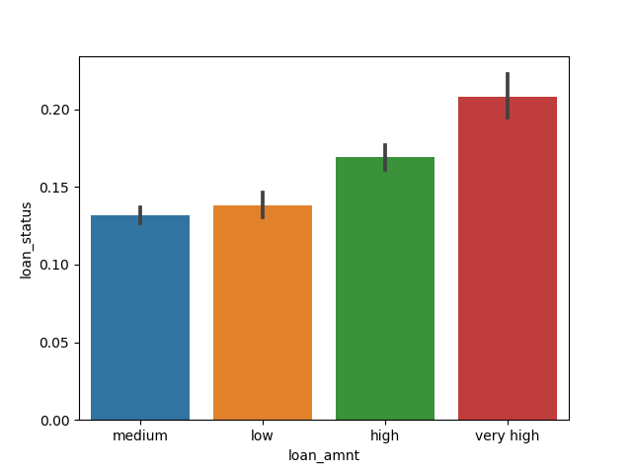
Analysis on Loan Amount
Trend that Loan Amount vs loan_status shows :-
Most defaulting borrowers have very high loan amount

Slide 9
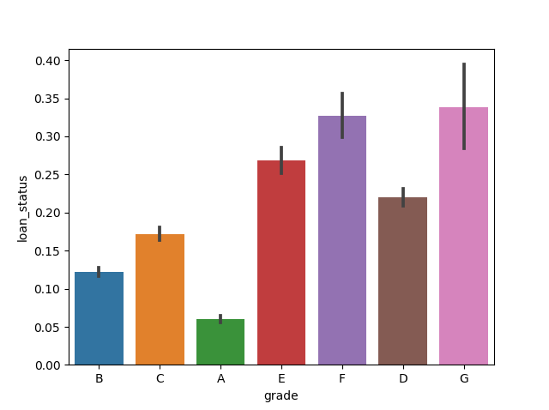
Analysis on Grade
Trend that Grade vs loan_status shows :-
Loans with Grade greater than C are most likely to be defaulted

Slide 10
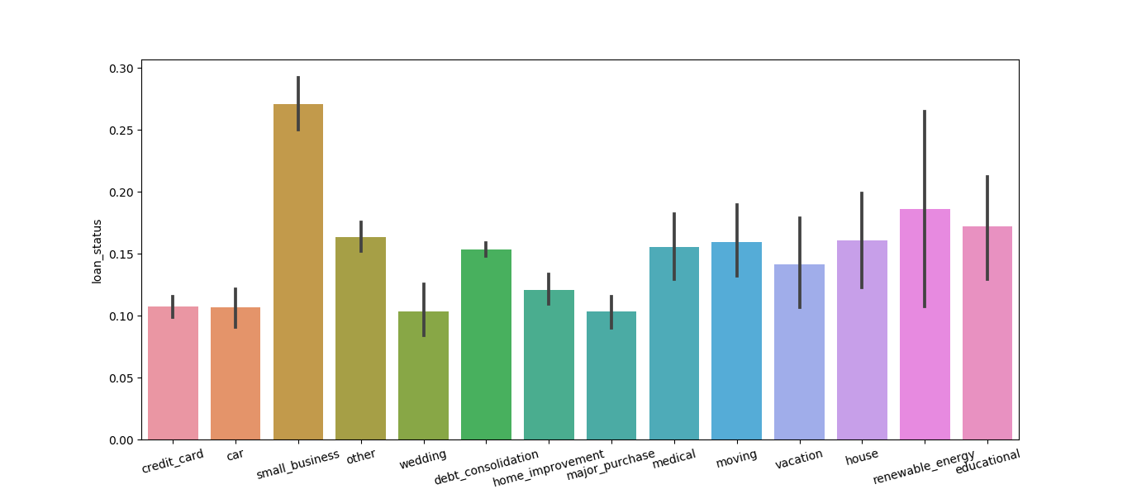
Analysis on Purpose of loan
Trend that Purpose vs loan_status shows :-
Most defaulting borrows mention purpose as SMALL BUSINESS

Slide 11
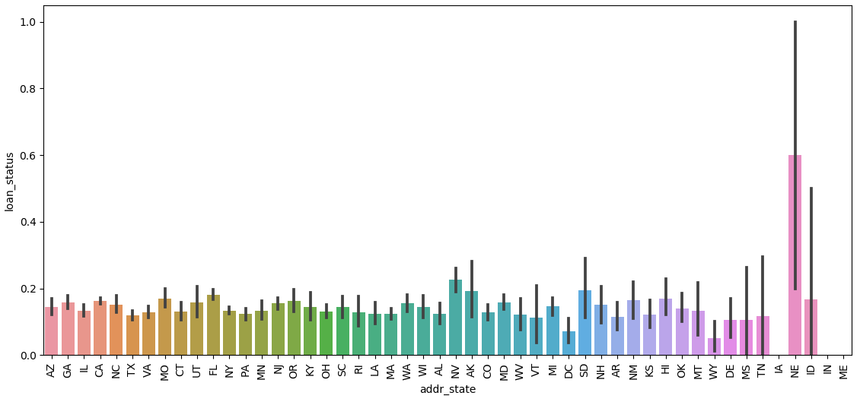
Analysis based on State
Trend that State vs loan_status shows :-
Most defaulting borrowers’ are from NEVADA

Slide 12
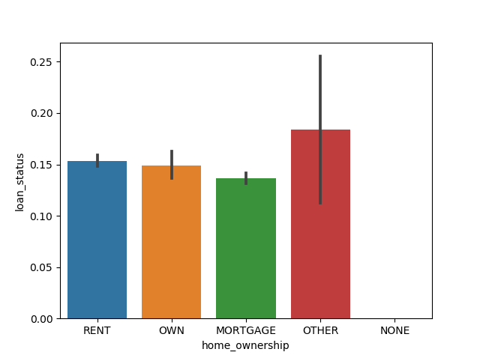
Analysis based on Home Ownership
Trend that Home Ownership vs loan_status shows :-
Most defaulting borrowers have “OTHERS” as ownership status

Slide 13
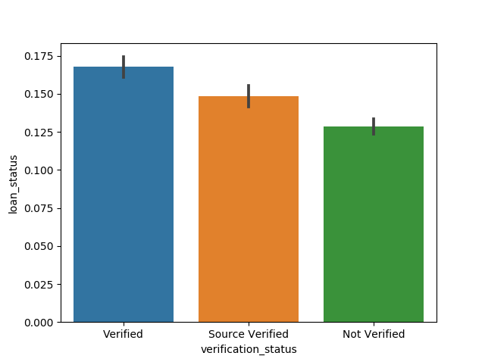
Analysis based on Verification Status
Trend that Verifiaction Status vs loan_status shows :-
Even though, LC has verified borrowers and borrowers sources, the percentage of defaulters is higher than “Not Verified” cases.

Slide 14
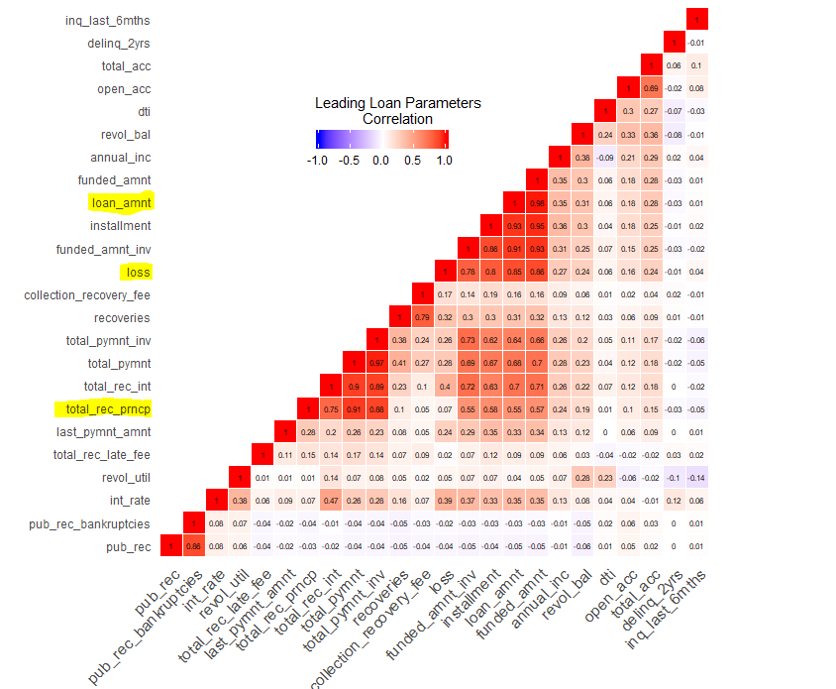
Correlation Matrix
• As we can see that for less Total_rec_prncp and high interest rate, percentage of defaulters are most.
• Less total_rec_prncp and moderate interest rate, defaulters are high.
• But we cant use total payment received because it is known only after once the loan is sanctioned
• Co-relation plot that Loan Amount is highly correlated(85%) with total received principal
• Credit Loss = Funded Amount – Principle returned
• Credit loss is highly correlated with loan amount, so we can take loan amount as one of the significant parameter while deciding defaulters

Slide 15
Conclusion
• As per as the analysis, we found few deciding factors which ends up in determining the loan defaulter applicant. So, the bank should consider the deciding factors before sanctioning the loan to avoid the credit loss.

